Slide 1
FRIENDSHIP PARADOX AND PERCEPTION BIAS
Keith Burghardt
March 20, 2024

Slide 2
Class size paradox
You arrive at a college that boasts average class size of 10 students
To confirm, you survey students at random about how large their class is
5
5
20
10
5
20
…
What is the average class size

Slide 3
Class size paradox
Average class size is …
Class 1
5
10
Class 2
5
20
Class 4
Class 3

Slide 4
Class size paradox
Size of class a student experiences on average is …
(average number of classmates)
Class 1
5
10
Class 2
5
20
Class 4
Class 3

Slide 5
Class size paradox
Average person is associated with larger events than the size of the average event.
Class 1
Average size of class is 10
Size of class an average student experiences is 12.75
5
10
Class 2
5
20
Class 4
Class 3

Slide 6
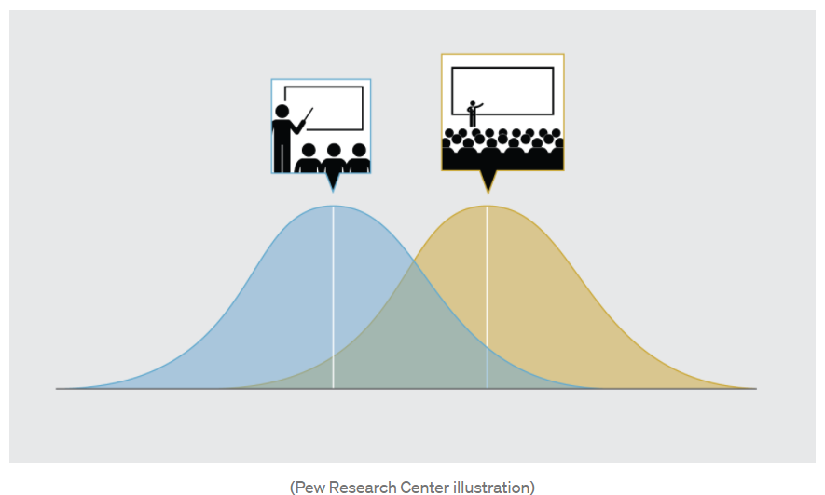
Class size paradox
Distribution of the perceived class size (number of classmates)
Distribution of the class size

Slide 7
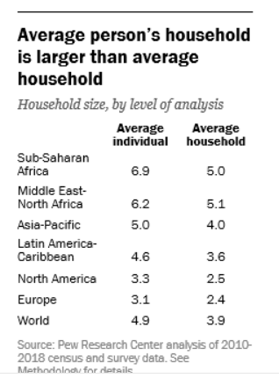
Households are larger at the individual level than at the group level
Discrepancies between the average household size and the average experienced by individuals tend to be largest in countries where typical households are large
The difference between household size as experienced by the average person in the world (4.9 members) is one whole person more than the size of the average household (3.9)
Notes:
https://medium.com/pew-research-center-decoded/the-class-size-paradox-how-individual-and-group-level-perspectives-differ-and-why-it-matters-b62071f4e909

Slide 8
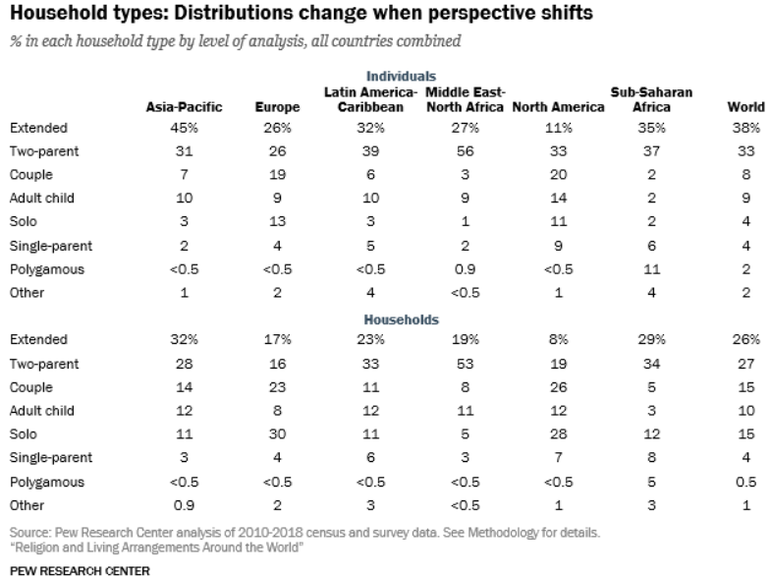
Differences by household type
Differences in the shares of people who live in different household types.
For example, 26% of households in the 130 countries contained extended families, but 38% of people in the same countries live in extended family households, making this the most common living arrangement in the world.
Solo households make up 15% of homes globally, but only 4% of people live alone.
Similar arguments for white people experience shops to be more crowded than they are, and freeways to be more congested than they really are
Notes:
https://medium.com/pew-research-center-decoded/the-class-size-paradox-how-individual-and-group-level-perspectives-differ-and-why-it-matters-b62071f4e909

Slide 9
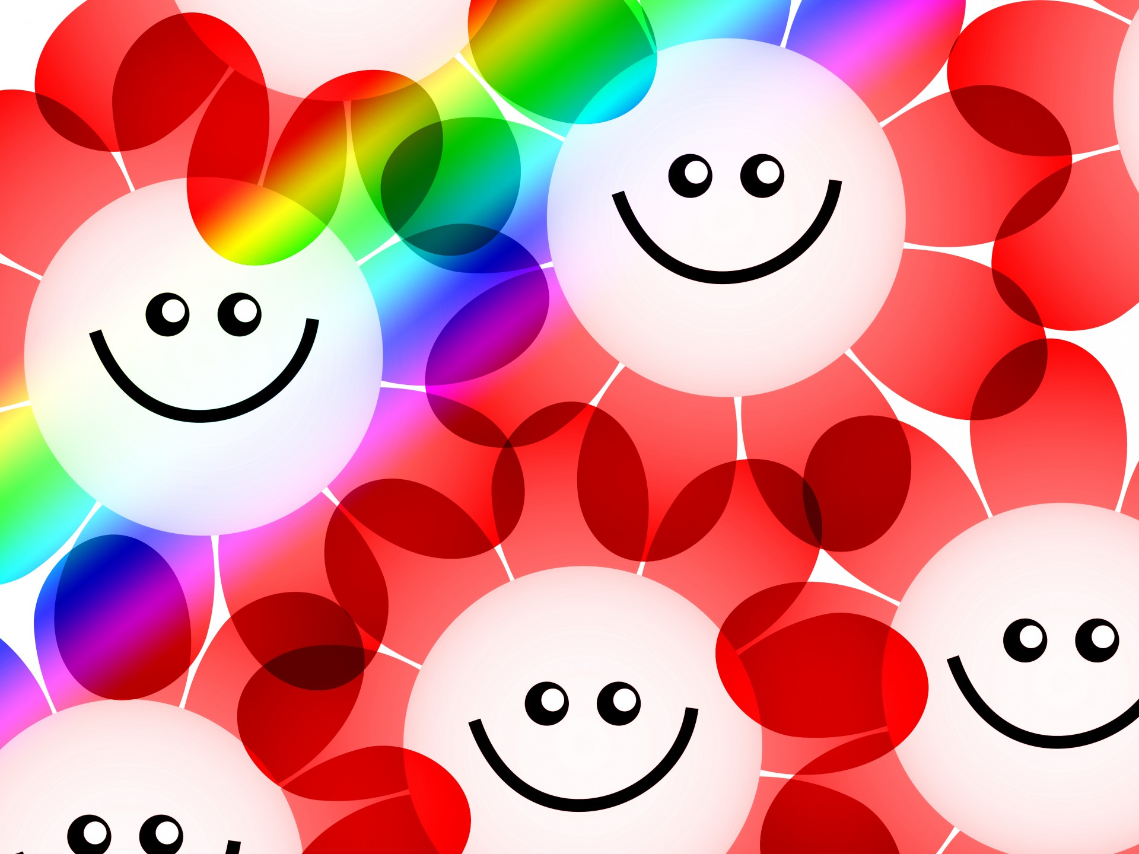

This explains why your perceptions are biased
Your friends are happier
Your friends drink more

Slide 10
The problem of binge drinking among (US) students
10-25% of college students are “heavy" or “problem" drinkers.
This causes issues:
collegiate adjustment problems
accidents
academic failure
vandalism
development of mental health disorders

Slide 11

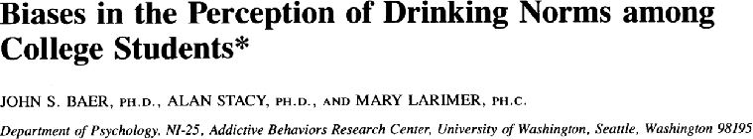
How many alcoholic drinks are consumed at a party? Virtually all students report that their friends drink more
Source: Most Students Do PartySafe@Cal

Slide 12
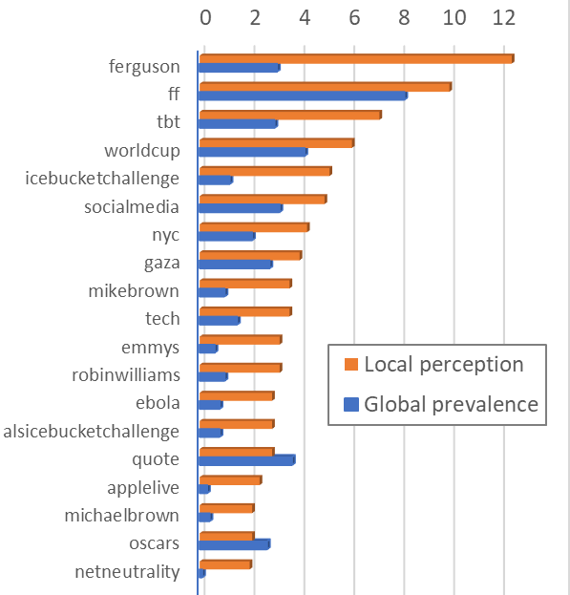
Twitter users overestimate the popularity of some topics
%
%
%
%
%
%
%
Compare global to local popularity of topics
Myself = Global popularity = fraction of all people talking about a topic
My Friends = Local popularity = fraction of friends talking about the topic
Topics: Popular Twitter hashtags in Summer 2014
Current events topics appear more popular than they really are
My Friends
Myself
[Alipourfard et al (2020) “Friendship paradox biases perceptions in directed networks”, Nature Communications]

Slide 13
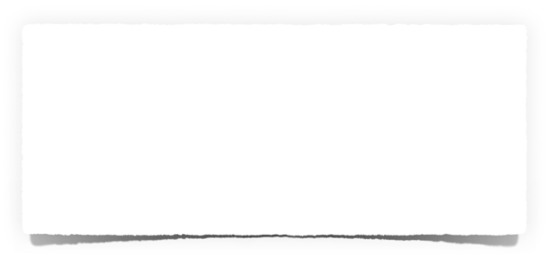
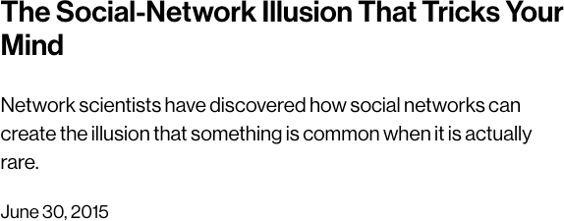
Why?
Friends are not a random sample of the population!
People seldom see representative sample of the population.
Instead, their samples — their friends – are highly biased samples of the population
This, in turn, biases their perception of how common different attributes are in the general population
These over- and underestimation errors, which we call perception biases, affect people’s judgements of minority- and majority-group sizes .

Slide 14
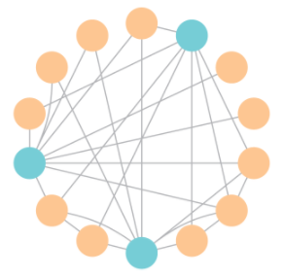

Social perception bias is a network effect
[Lerman, Wu & Yan (2016) The “Majority Illusion” in Social Networks, in Plos One.]

Slide 15
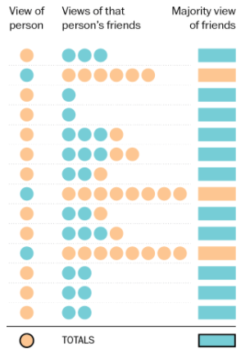
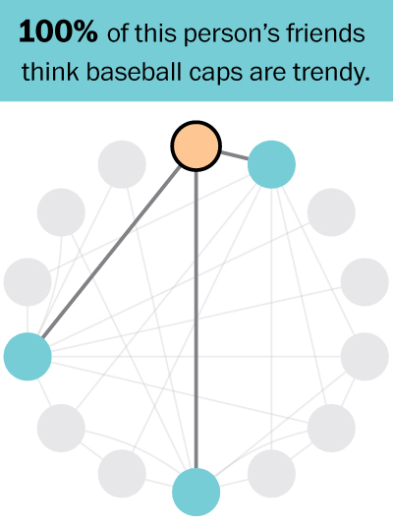
Local vs global views
K. Schaul, “A quick puzzle to tell whether you know what people are thinking”, Wonkblog, Washington Post
https://www.washingtonpost.com/graphics/business/wonkblog/majority-illusion/
Notes:
A minority opinion can appear to be very popular within many social circles.

Slide 16
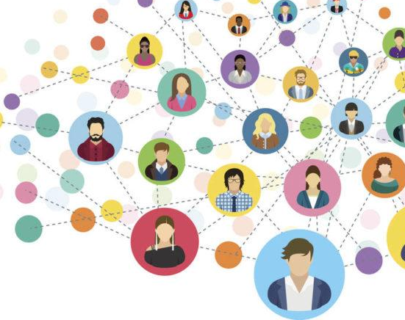
FRIENDSHIP PARADOX IN NETWORKS

Slide 17
Friendship paradox
Your friends have more friends than you do, on average [Feld, 1991]

Slide 18
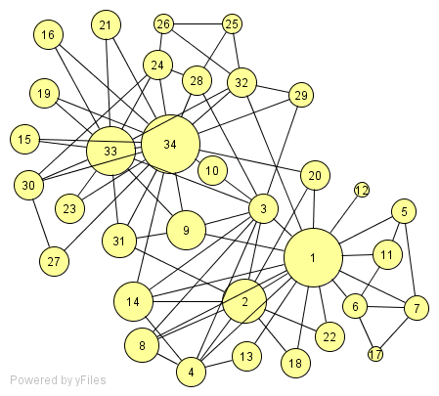
Friendship paradox
Your friends have more friends than you do, on average [Feld, 1991]
3
3
4
6

Slide 19
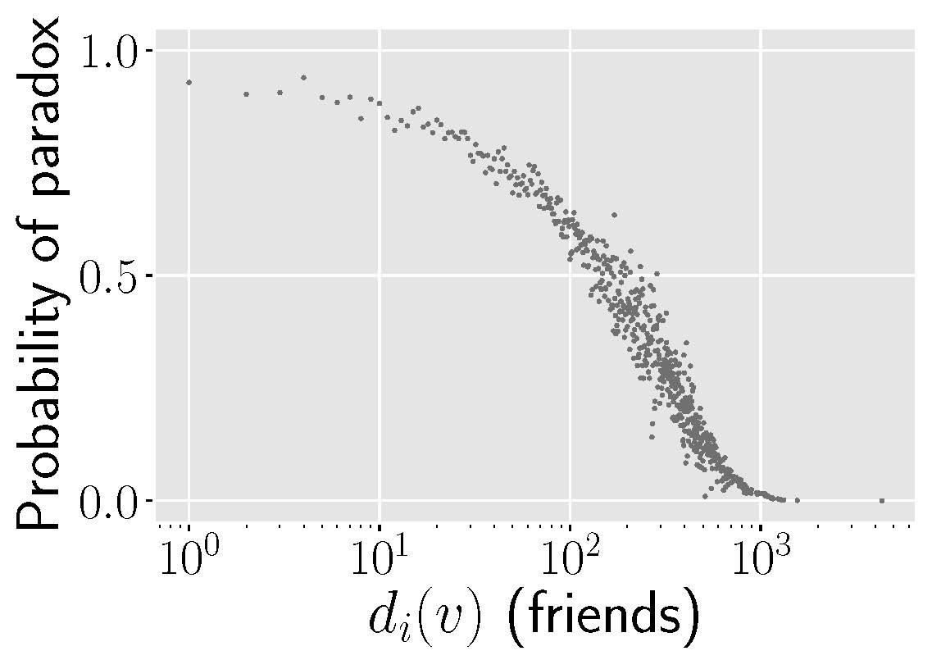
Friendship paradox
Your friends have more friends than you do, on average [Feld, 1991]
2
3
3
2
5
4
2
6
3
2
2
3
4
1
2
3
4
5
2
3
5
4
4
4
2
2
2
2
4

Slide 20
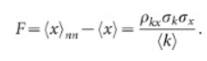
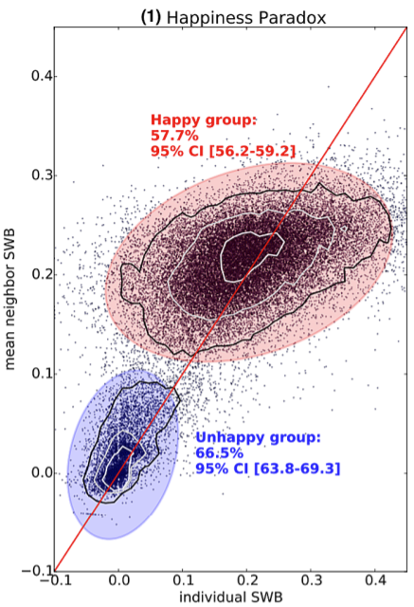
Friendship paradox
Your friends have more friends than you do, on average [Feld, 1991]
Generalized friendship paradox
Your friends are more X than you are, on average [Hodas et al., 2013, Eom & Jo, 2014]
Your friends are happier than you are, on average (Bollen 2017)
Your coauthors are more productive and more recognized than you are, on average (Eom & Jo 2014)
Your coauthors have more impact than you do, on average (Benevenuto 2016)
True whenever more popular people have more X

Slide 21
Friendship paradox
Your friends have more friends than you do, on average [Feld, 1991]
Generalized friendship paradox
Your friends are more X than you are, on average [Hodas et al., 2013, Eom & Jo, 2014]
Perception bias
Some traits appear more popular within social circles than they really are [Alipourfard et al, 2020]

Slide 22
Perception bias on Twitter: users overestimate the popularity of some topics
%
%
%
%
%
%
%
Compare global to local popularity of topics
Myself = Global popularity = fraction of all people talking about a topic
My Friends = Local popularity = fraction of friends talking about the topic
Topics: Popular Twitter hashtags in Summer 2014
Current events topics appear more popular than they really are
My Friends
Myself
[Alipourfard et al (2020) “Friendship paradox biases perceptions in directed networks”, Nature Communications]

Slide 23
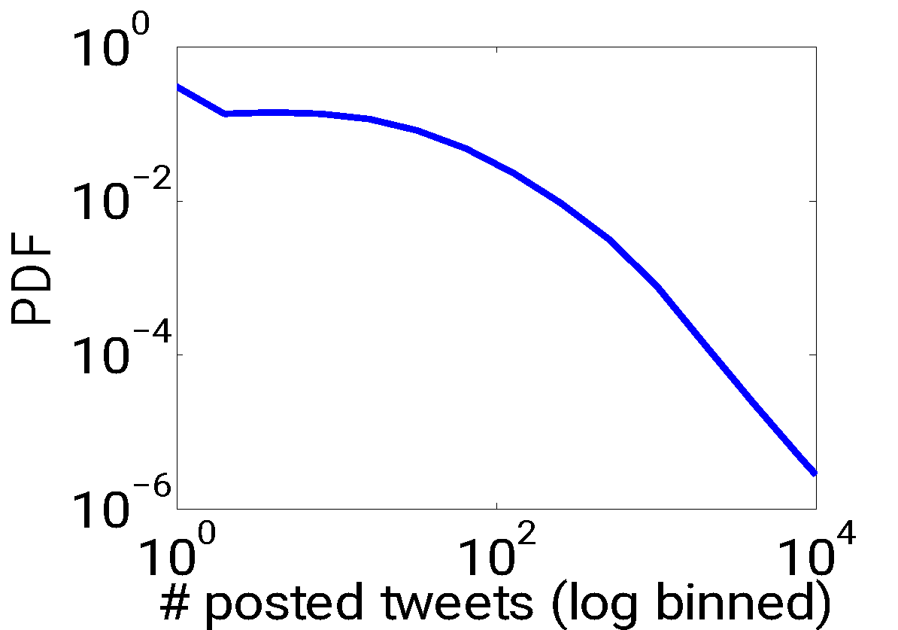
Friendship paradox as a byproduct of sampling from a heterogeneous distribution
your value 🡪 x
your friends’ values 🡪 x₁, …, x_{k}
x

Slide 24
Friendship paradox as a byproduct of sampling from a heterogeneous distribution
your value 🡪 x
your friends’ values 🡪 x₁, …, x_{k}
x
Sample mean grows with k

Slide 25
Friendship paradox as a byproduct of sampling from a heterogeneous distribution
your value 🡪 x
your friends’ values 🡪 x₁, …, x_{k}
x
🡪 use the median instead

Slide 26
Friendship paradox
Your friends have more friends than you do, on average [Feld, 1991]
Strong friendship paradox
Most of your friends have more friends than you do [Kooti et al., 2014]

Slide 27
Strong friendship paradox
Most of your friends have more friends than you do
[Kooti, Hodas and Lerman, 2014].
12
16
4
5
7
Notes:
Implications
People use local network as a source of information. Systematic biases. Correlation of chars with deg.
People with more friends are more likely to get infected. Consider friends of a random sample, instead of the random sample, early on.
Friendship paradox is interesting for us to know, but it also has some real-world implications.
E.g., since people use their local network as a source of information, the friendship paradox leads to systematic biases in our perceptions. This is because many characteristics, such as drug and alcohol use and wealth correlate with high network degree. This makes people to overestimate these characteristics in the social network.
Moreover, studies have shown that people with more friends are more likely to get infected by a pathogenic outbreak. So, if we consider a random sample and check the friends of the random sample for the outbreak, we will have higher change in detecting the outbreak in early days. This was shown both in virtual and real-world.

Slide 28
Strong friendship paradox
Most of your friends have more friends than you do
[Kooti, Hodas and Lerman, 2014].
2
3
3
2
4
2
3
2
2
3
4
1
2
3
4
5
2
3
5
4
2
2
2
2
4
Notes:
Implications
People use local network as a source of information. Systematic biases. Correlation of chars with deg.
People with more friends are more likely to get infected. Consider friends of a random sample, instead of the random sample, early on.
Friendship paradox is interesting for us to know, but it also has some real-world implications.
E.g., since people use their local network as a source of information, the friendship paradox leads to systematic biases in our perceptions. This is because many characteristics, such as drug and alcohol use and wealth correlate with high network degree. This makes people to overestimate these characteristics in the social network.
Moreover, studies have shown that people with more friends are more likely to get infected by a pathogenic outbreak. So, if we consider a random sample and check the friends of the random sample for the outbreak, we will have higher change in detecting the outbreak in early days. This was shown both in virtual and real-world.

Slide 29
Friendship paradox is very common…
Network | Type | Nodes | Probability of paradox
LiveJournal | Social | 3,997,962 | 84%
Twitter | Social | 780,000 | 98%
Skitter | Internet | 1,696,415 | 89%
Google | Hyperlink | 875,713 | 77%
ProsperLoan | Social Finance | 89,269 | 88%
ArXiv | Citation | 34,546 | 79%
WordNet | Semantic | 146,005 | 75%
But wait, there is more…

Slide 30
Friendship paradox
Your friends have more friends than you do, on average [Feld, 1991]
Strong friendship paradox
Most of your friends have more friends than you do [Kooti et al., 2014]
Generalized friendship paradox
Your friends are more X than you are, on average [Hodas et al., 2013, Eom & Jo, 2014]
Generalized strong friendship
Most of your friends are more X than you are [Kooti et al, 2014]
Perception bias
Some traits appear more popular within social circles than they really are [Alipourfard et al, 2020]
Majority illusion
Most of your friends have a trait, even when it is rare. [Lerman et al, 2016]

Slide 31
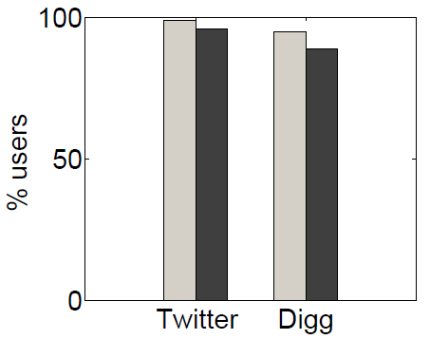
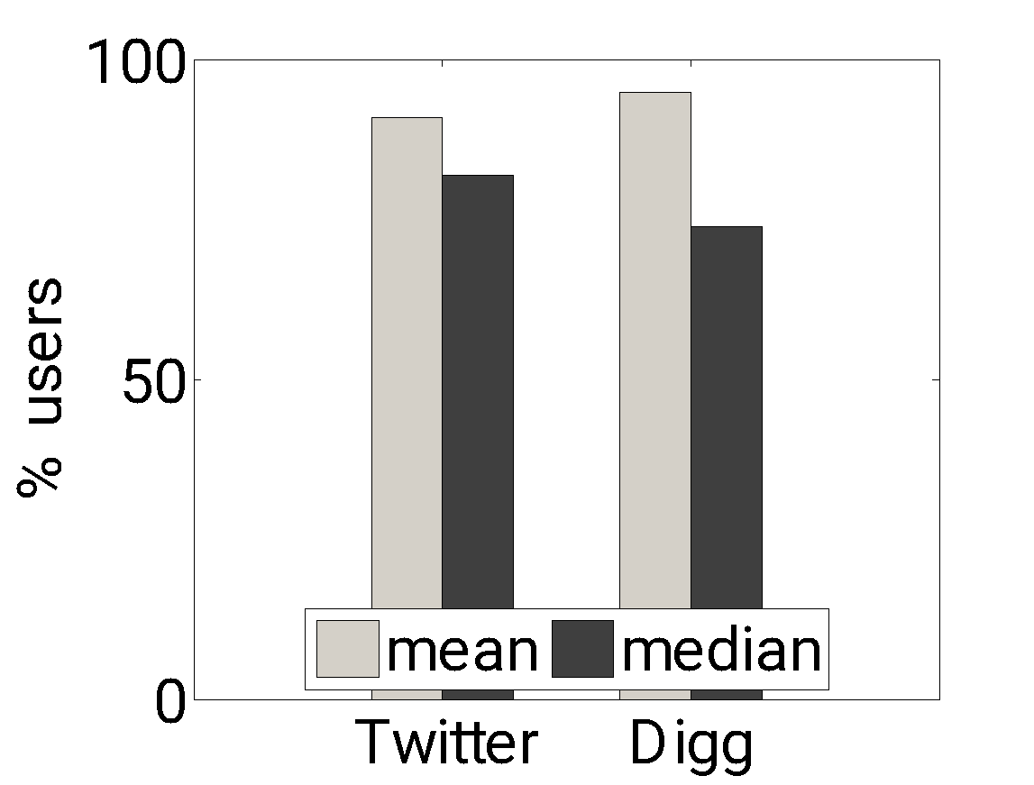
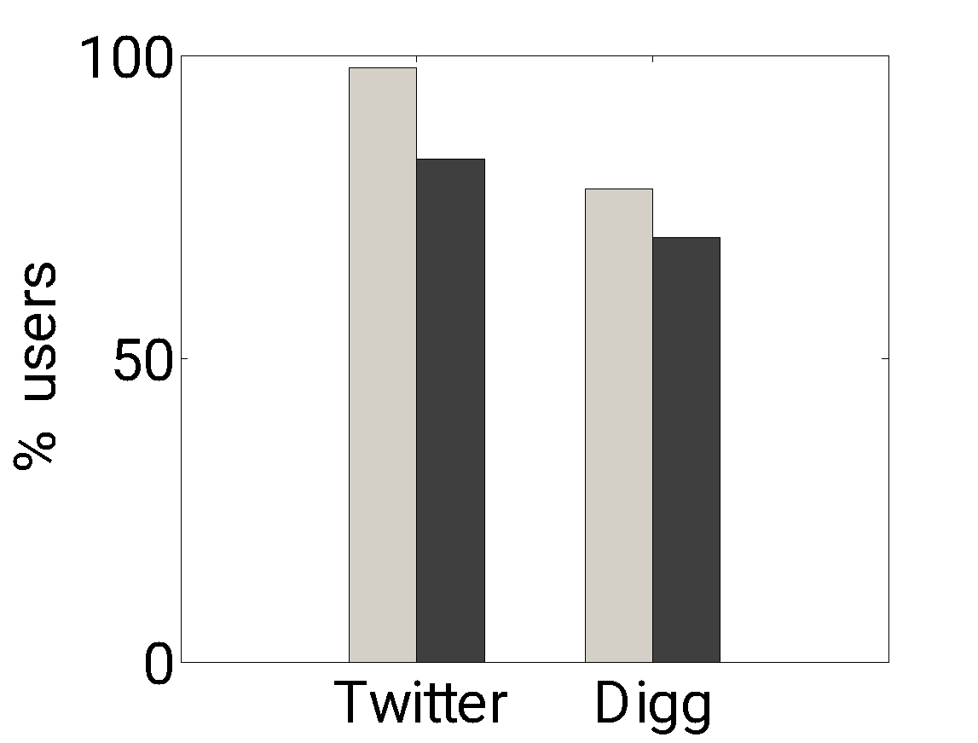
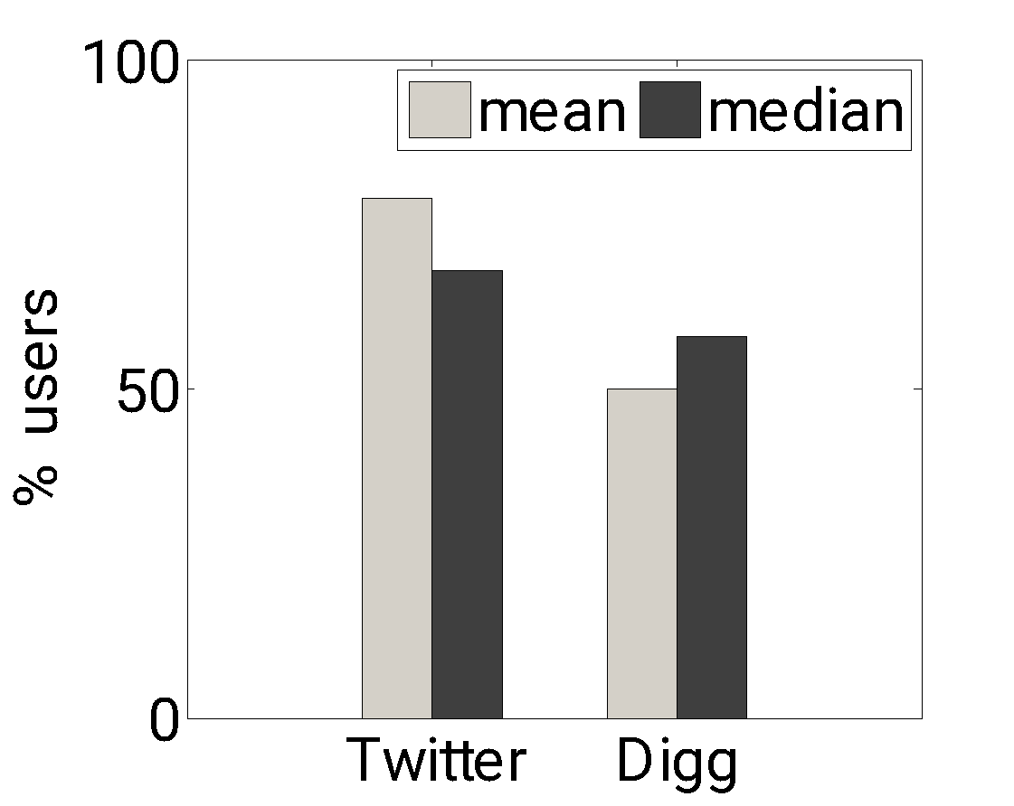
Strong Friendship Paradox
Strong Activity Paradox
Strong Diversity Paradox
Strong Virality Paradox
Most of your friends (& followers) are more popular than you are
Most of your friends tweet more than you do
Most of your friends see more diverse content than you do
Most of your friends see more viral content than you do
weak
strong
weak
strong
[Kooti, et al (2014) “Network Weirdness: Exploring the origins of network paradoxes” in ICWSM]

Slide 32
QUANTIFYING FRIENDSHIP PARADOX: THE ROLE OF NETWORK STRUCTURE

Slide 33
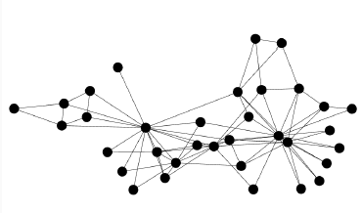
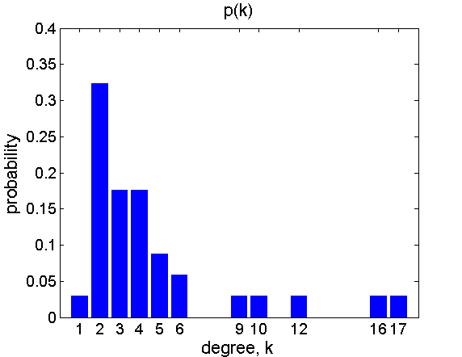
Degree distribution
Node degree distribution p(k)
Probability that a randomly selected node has degree k.
Explains Feld’s friendship paradox
Any skewed degree distribution (variance > 0) will lead to a paradox

Slide 34
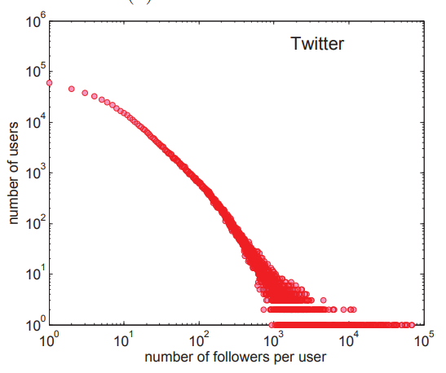
Distribution of popularity on Twitter (ca 2010)
Vast majority have
few followers
A few have
many followers

Slide 35
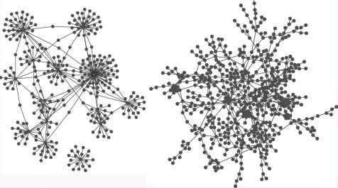
Assortativity
… Nodes do not link at random
Joint degree distribution of connected pairs of nodes e(k,k’)
Probability that a randomly selected edge links nodes with degrees k and k’
Explains Feld’s friendship paradox, but not strong one
Degree assortativity
MEJ Newman, Assortative Mixing in Networks, Phys Rev Lett 89 208701 (2002)
disassortative
assortative

Slide 36
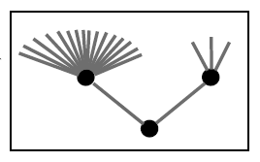
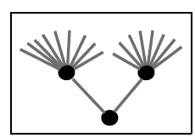
Transsortativity
… nodes do not link at random
Joint degree distribution of connected triplets of nodes
Transsortativity: neighbors tend to have similar degrees
Networks can have the same lower-order structure (degree and joint degree distributions) but different higher-order structure
Ngo, Percus, Burghardt & Lerman. The Transsortative Structure of Networks, in RSPA (2020)
negative
transsortativity
positive
transsortativity

Slide 37
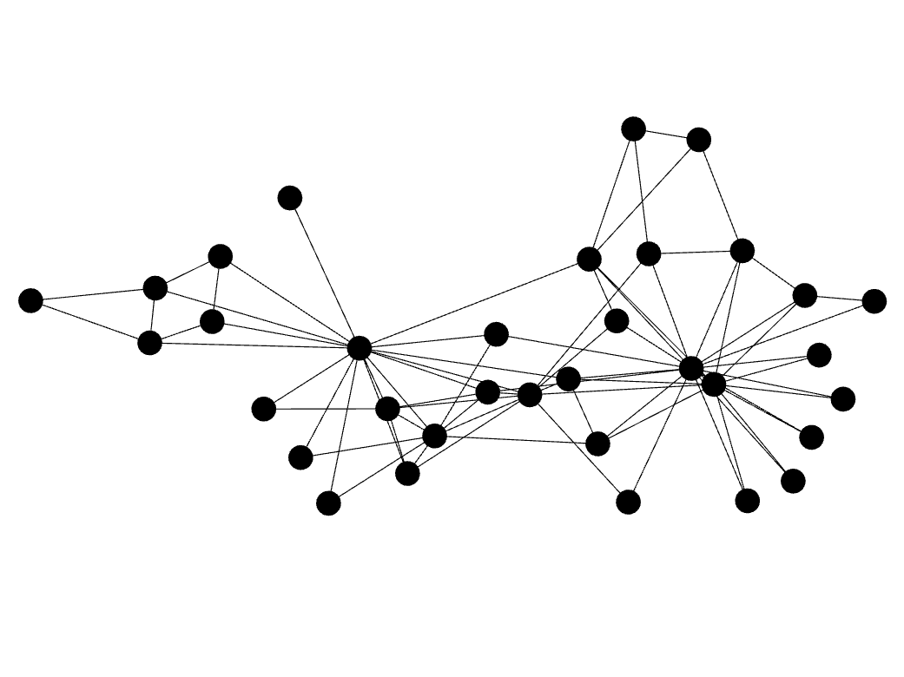
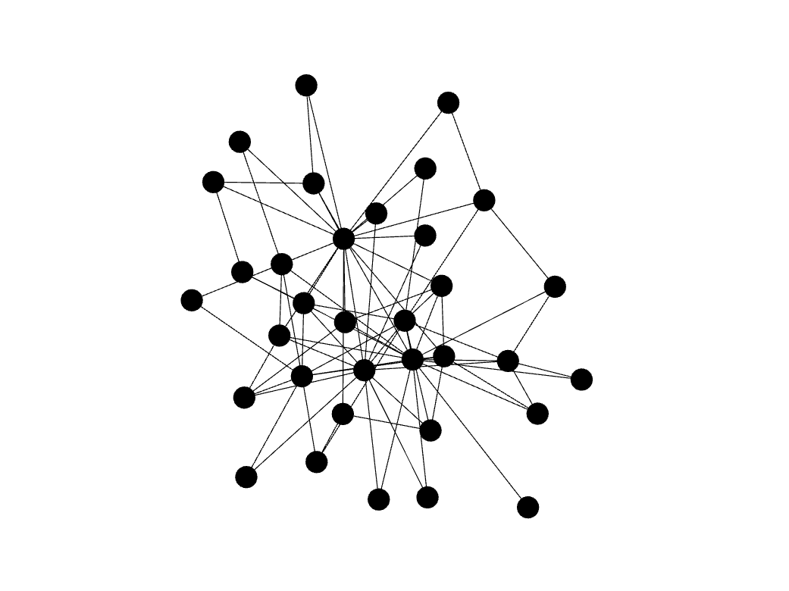
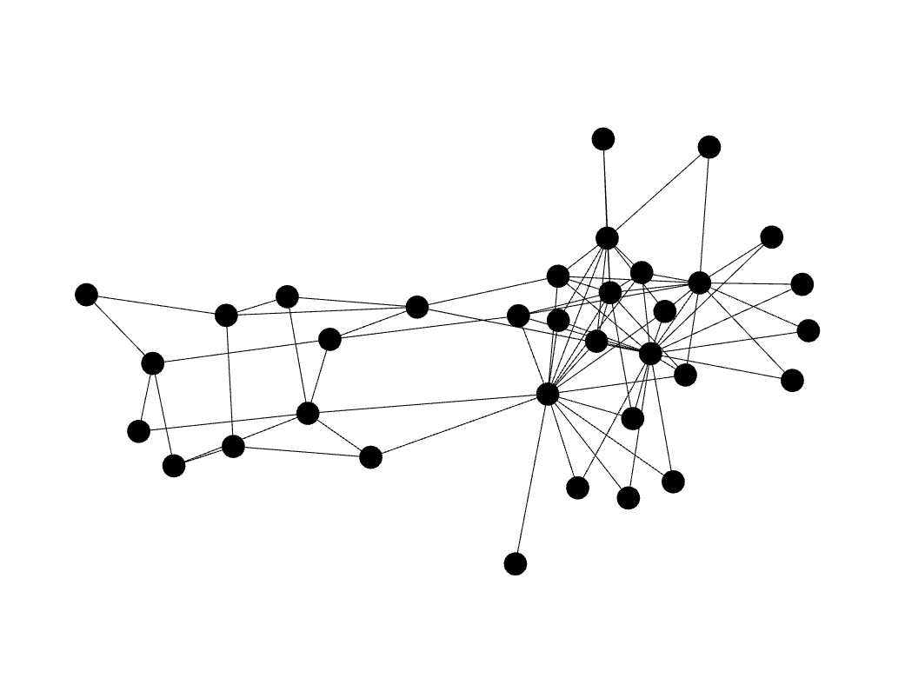
Transsortativity changes network structure
negative
transsortativity
positive
transsortativity
original network
* all networks have the same lower order structure: degree and joint degree distributions
[Ngo, Percus, Burghardt & Lerman (2020) The Transsortative Structure of Networks, in J Royal Society Proc. A]

Slide 38
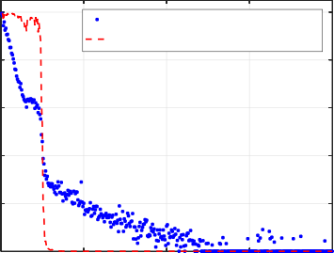
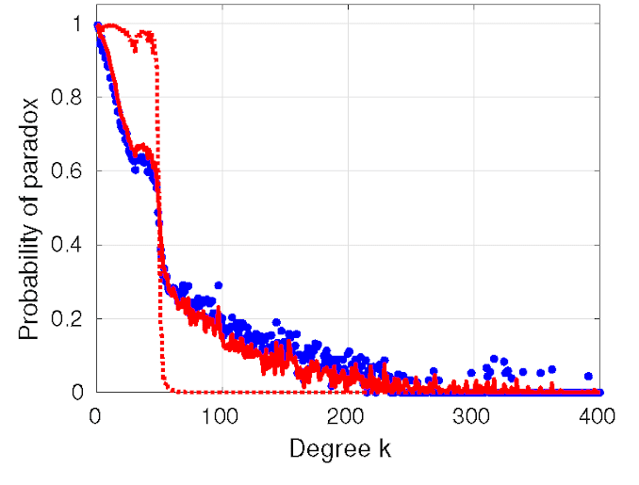
Transsortativity explains strong friendship paradox
Given a network, calculate the fraction of degree-k nodes the majority of whose neighbors have a higher degree
1
Empirical (Skitter internet)
assortativity model prediction
Empirical (Skitter internet)
assortativity model prediction
transsort. model prediction
0.8
0.6
0.4
0.2
0
* transsortative structure is sufficient to explain the paradox
Probability of paradox
0
100
200
Degree k
300
400
[Wu et al (2017) “Neighbor-neighbor correlations explain measurement bias in networks” Scientific Reports 7]

Slide 39
From friendship paradox to “majority Illusion”
Nodes have a trait: active/not, yellow/blue, heavy drinker/teetotaler, …
Trait can be rare, but many nodes will overestimate its prevalence
[Lerman, Wu & Yan (2016) The “Majority Illusion” in Social Networks, in Plos One.]

Slide 40
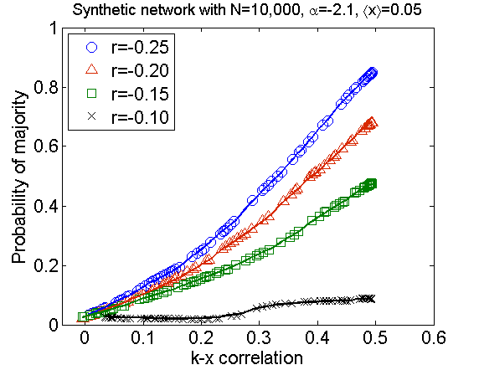
Network structure & majority illusion
Network structure can amplify the majority illusion when:
Influential (high degree) nodes are likely to have the trait: k-x correlation measures likelihood high-degree nodes have the trait
Skewed degree distribution: few high-degree nodes amplify the effect
Disassortativity: High degree nodes link to low degree nodes: negative assortativity (r_{2k}<0)
Synthetic network with 5% blue nodes
[Lerman, Wu & Yan (2016) The “Majority Illusion” in Social Networks, in Plos One.]

Slide 41
Inequalities in social networks
Lee, E., Karimi, F., Wagner, C., Jo, H. H., Strohmaier, M., & Galesic, M. (2019). Homophily and minority-group size explain perception biases in social networks. Nature Human Behaviour, 1-10.
1.) Homophily influences ranking of minorities
Minorities are more affected by homophilic interactions and their group size than majorities
2.) Homophily can impact perception of groups
Evidence for perception biases on social network and population levels, can be (partially) mitigated

Slide 42
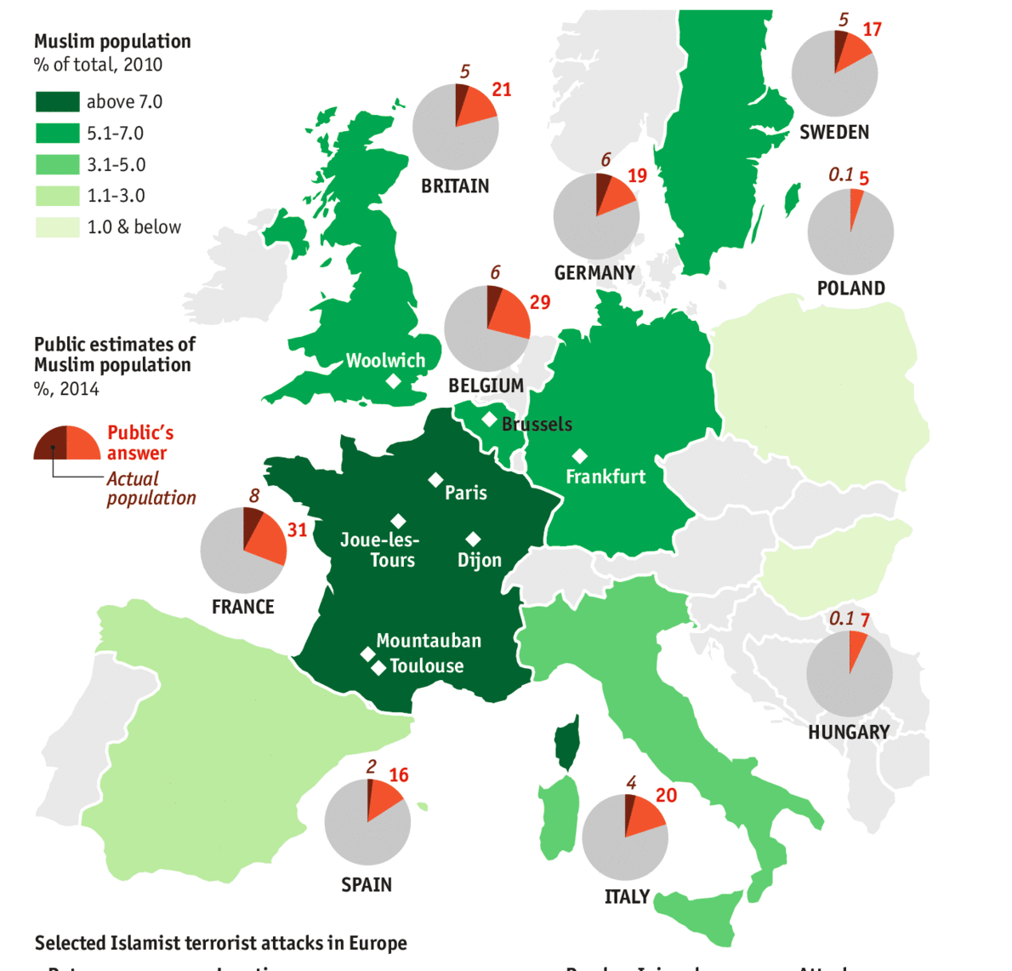
Perception of minorities
Slide courtesy of Markus Strohmaier

Slide 43
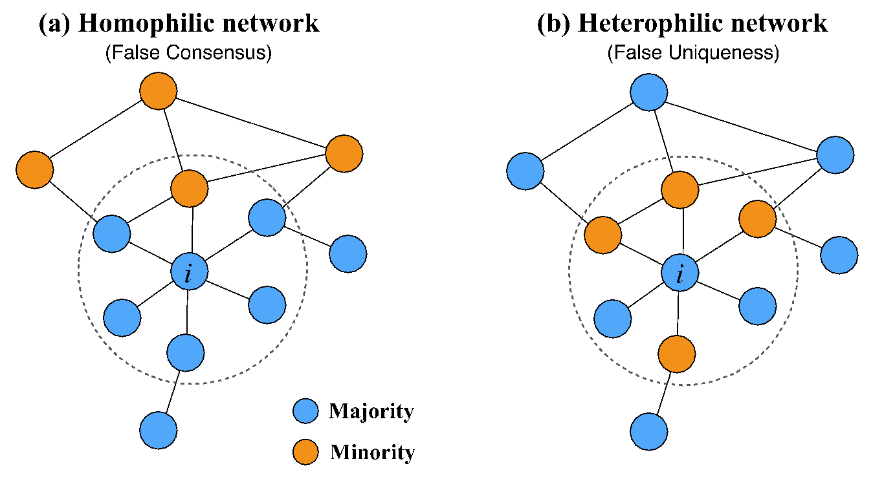
Perception of minorities in social networks
P_{indiv}(i) = 1/6 ≈ 16% (0.5 fold underestimation)
P_{indiv}(i) = 4/6 ≈ 67% (2 fold overestimation)

Slide 44
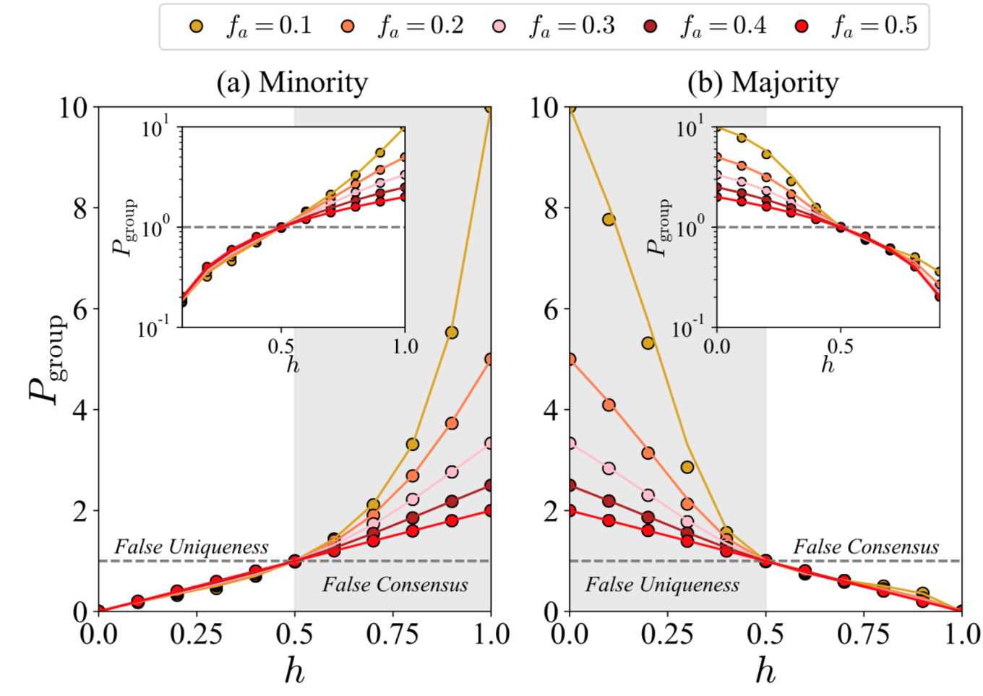
Perception bias vs. homophily and minority size
Estimates of the size of the minority
minority size overestimated
minority size underestimated

Slide 45
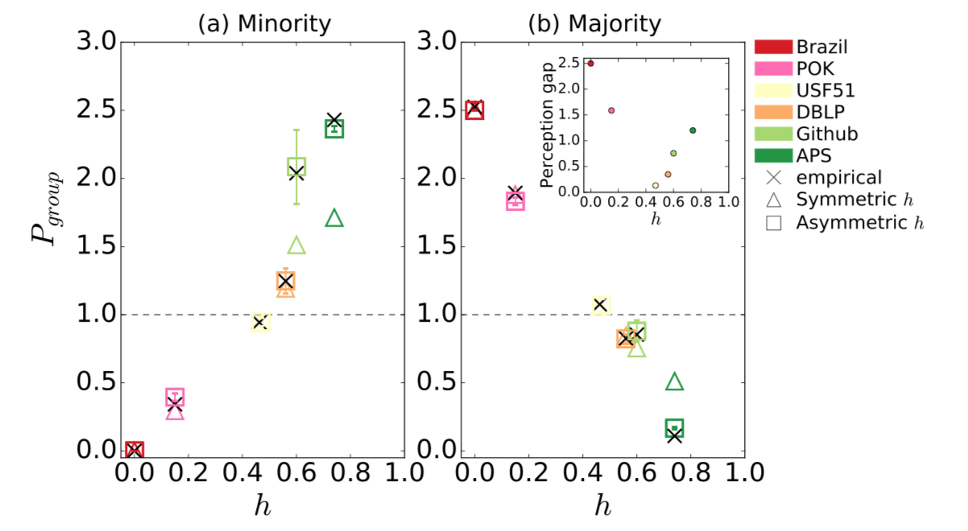
Perception bias in empirical data
Estimates of the size of the minority
minority size overestimated
minority size underestimated

Slide 46
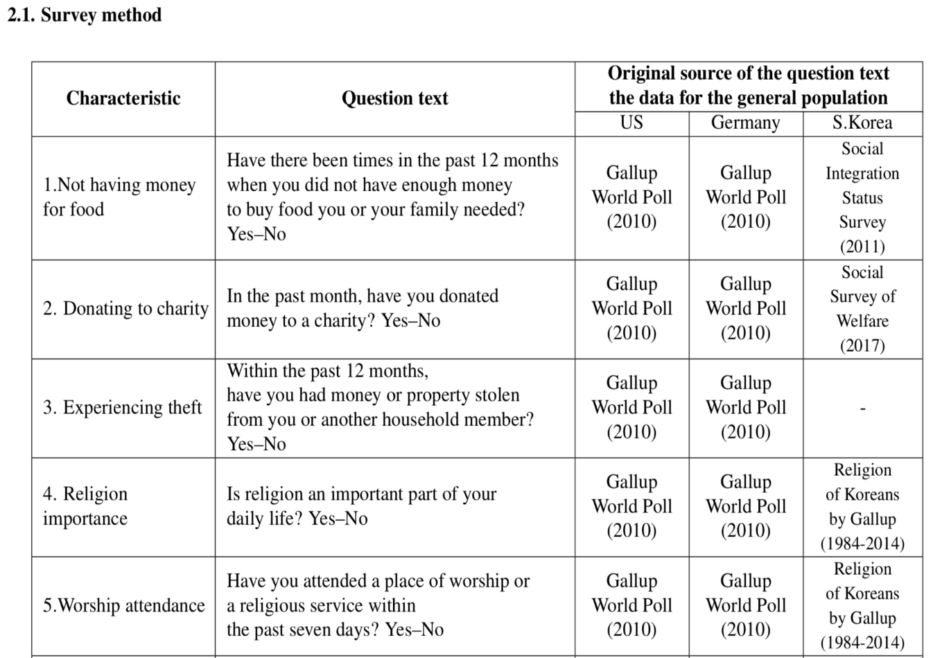
Can we observe similar perception biases on a national level?
International survey programs including the US, Germany and South Korea:

Slide 47
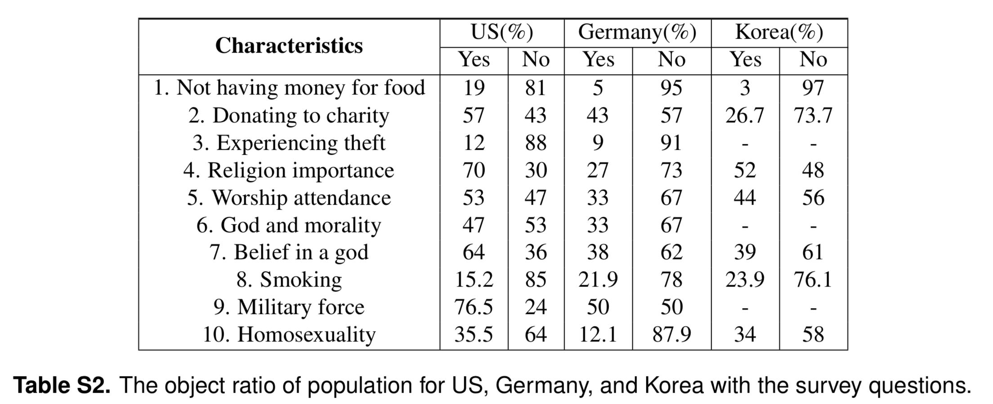
Can we observe similar perception biases on a national level?
Examples of different minority / majority issues:
+ a crowdworker survey (n=300) asking:
Do you have characteristic x?
How frequent is characteristic x in your personal network?
How frequent is characteristic x in the population of your country?

Slide 48
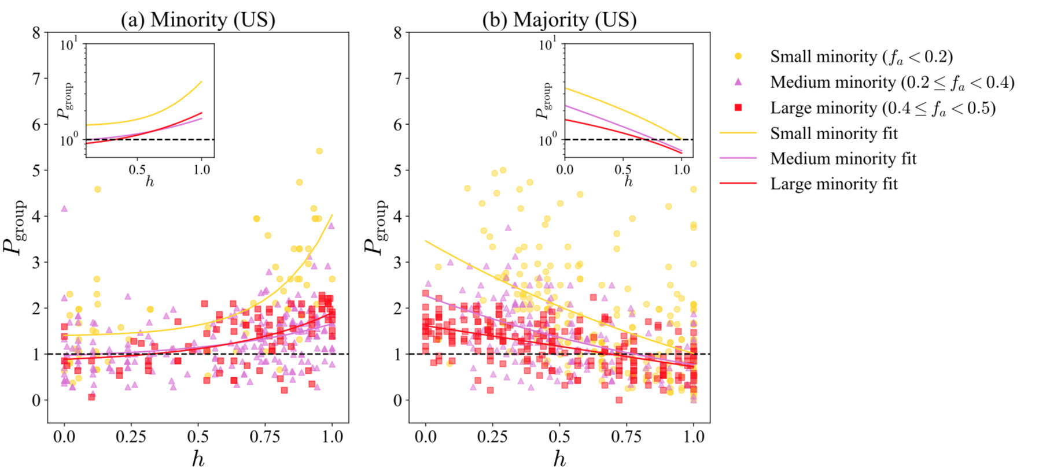
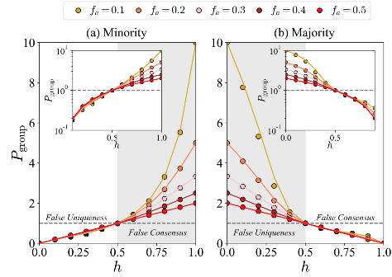
Perception of minorities on a population level
Results for minority/majority estimates from the US (results similiar for Germany):
minority size overestimated
minority size underestimated

Slide 49
Summary
Friends are not a representative sample of the population
As a result, your observations/perceptions will be systematically biased
E.g., a rare attribute appears far more common than it is
Impacts
Ranking/visibility of minorities in networks
Link and content recommendation in networks
Psychological well-being
Upward social comparison
Loneliness and Facebook use: the role of social comparison and rumination (PMID: 33521361)

